Slide 1
Build your own copilot with Azure AI Studio
Ashish Sharma, Microsoft Azure MVP
Cloud Solution Architect

Slide 2

Who am I?

Slide 3









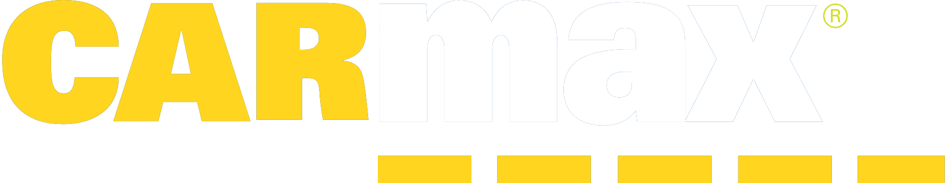













































Over 21,000 customers

Slide 4
Microsoft’s Copilots
Security Copilot
Bing Chat
Microsoft 365 Copilot
Power Platform Copilot
Dynamics 365 Copilot
Windows Copilot

Slide 5
AI safety and security
Copilot Studio
Microsoft Copilot
Your copilots
Microsoft apps
Copilot Stack
AI orchestration
Your data
Foundation models & AI toolchain
AI infrastructure
Microsoft Cloud

Slide 6


Azure AI Studio
Public Preview
https://ai.azure.com

Slide 7

Data is the fuel that powers AI
Data is the fuel that powers AI

Slide 8
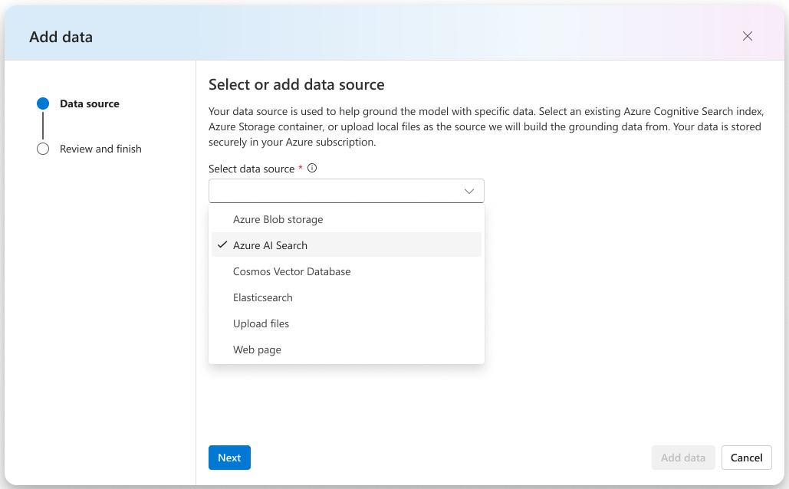
Integrate structured & unstructured data
Blob storage
Azure Data Lake (ADLS)
Fabric OneLake
Local files/folders
S3 via OneLake shortcut
Azure AI Search
… countless others

Slide 9

Latest Azure OpenAI Service models
Announcing
Preview
GPT-4 Turbo
Preview
GPT-4 Turbo with Vision
Preview
DALL·E-3
Preview
Assistants API
Preview
Fine-tuning for GPT-4

Slide 10
Azure OpenAI Service
GPT-4 Turbo with Vision
Enable multimodal GenAI with video, image, and text
Unlock new scenarios with integrated Azure AI Vision support
Augment RAG pattern with images and Azure AI Search
To learn more, join us for BRK205: "Multimodal Conversational Interfaces with GPT and Vision AI"

Slide 11
Azure AI
Your data is your data
Your data is not used to train the foundation AI models
Build on trust
Your data is protected by the most comprehensive enterprise compliance and security controls
To learn more, join us for BRK202: "What's new in Generative AI"

Slide 12

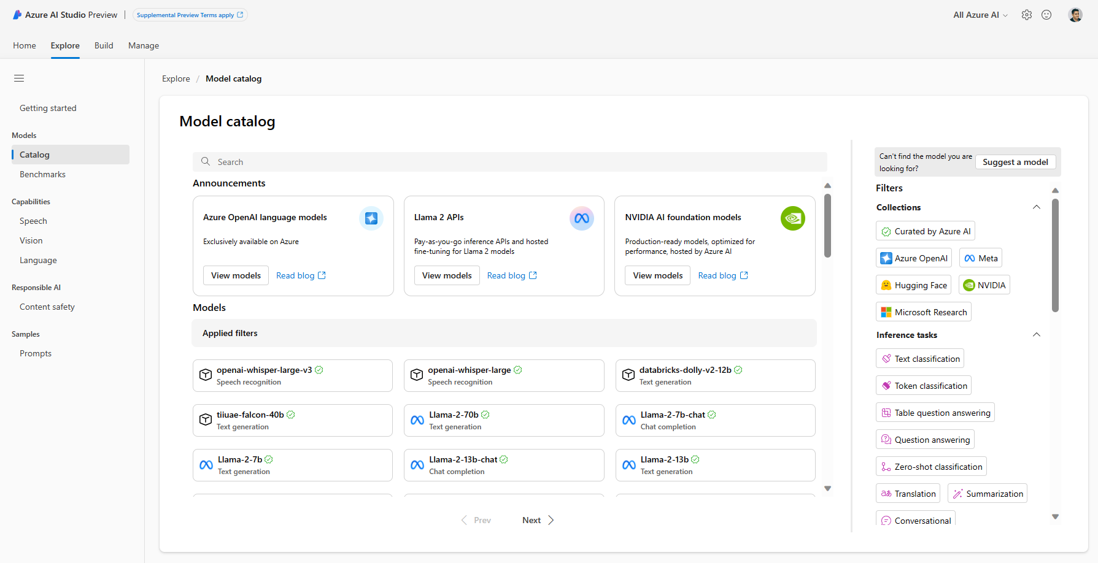
Model catalog: quality and quantity
Azure OpenAI GPT-4, GPT-4 Turbo, GPT 3.5, ChatGPT, DALL-E
Deploy & fine tune on your infra Curated by Azure AI: Phi-2, Falcon, Databricks Dolly-v2, Stable Diffusion, and more Hugging Face: 1000s of OSS models

Slide 13
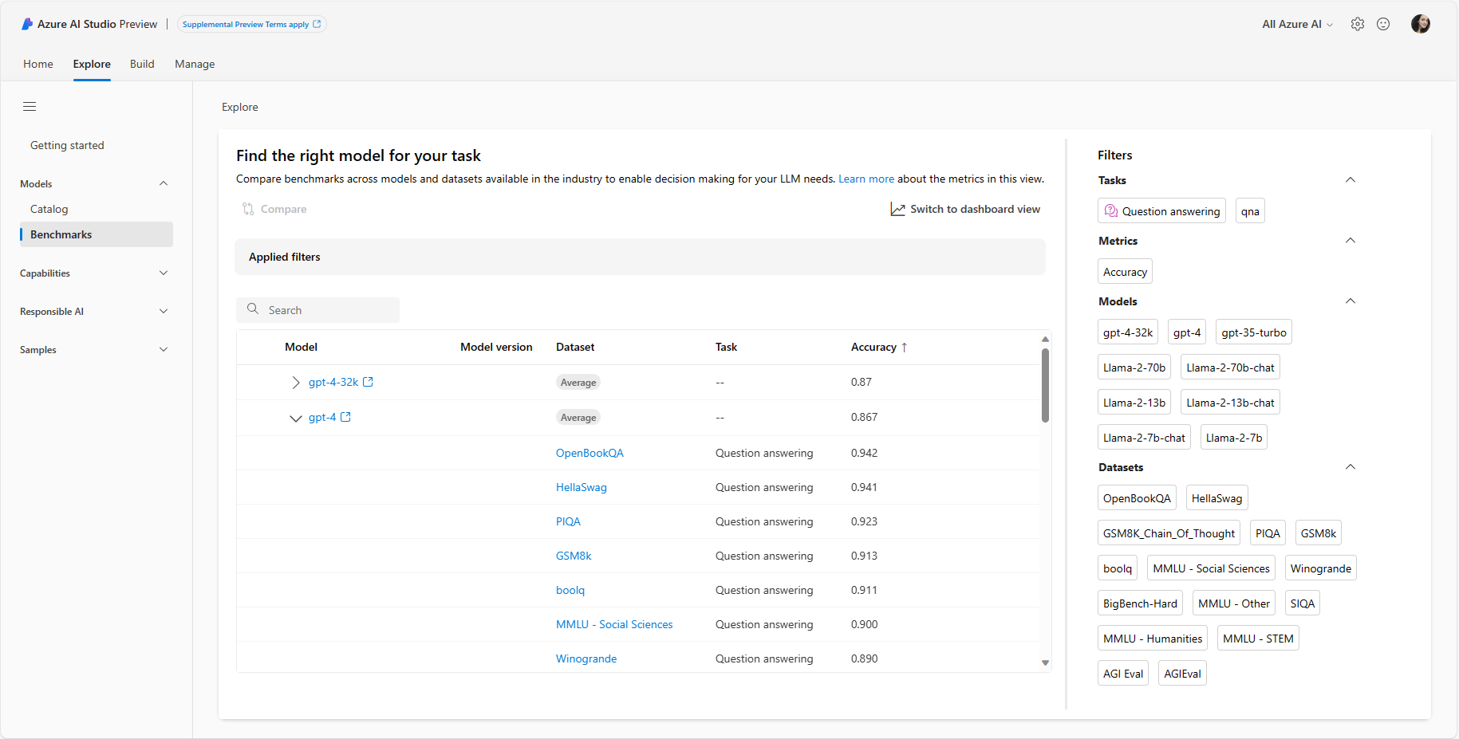
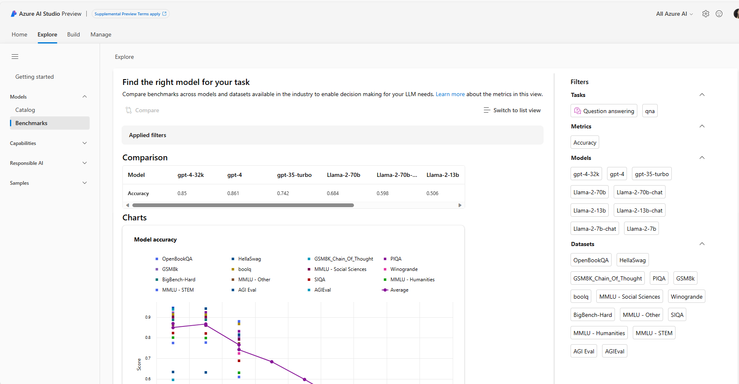
Model benchmarking
Announcing
Model benchmarks will offer users a comprehensive comparison view for benchmarking metrics of foundation models in the model catalog
This will allow users the opportunity to self-educate and make informed decisions about the sustainability of models and datasets prior to initiating any job

Slide 14
Microsoft’s responsible AI principles
Fairness
Reliability
& safety
Privacy &
security
Inclusiveness
Transparency
Accountability

Slide 15
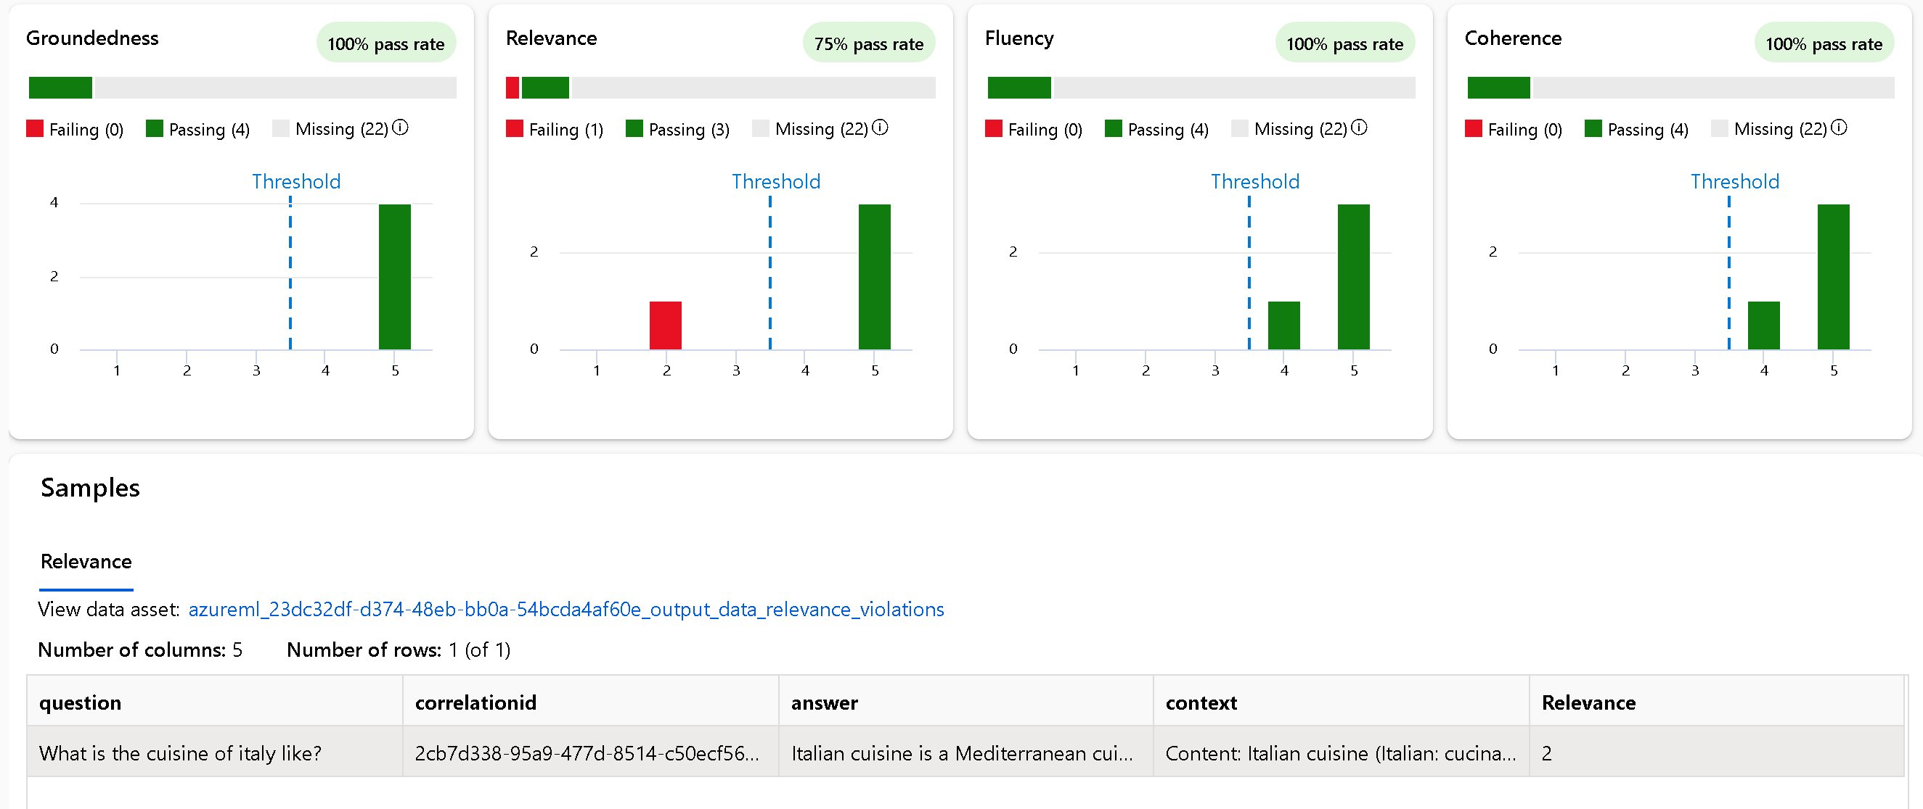
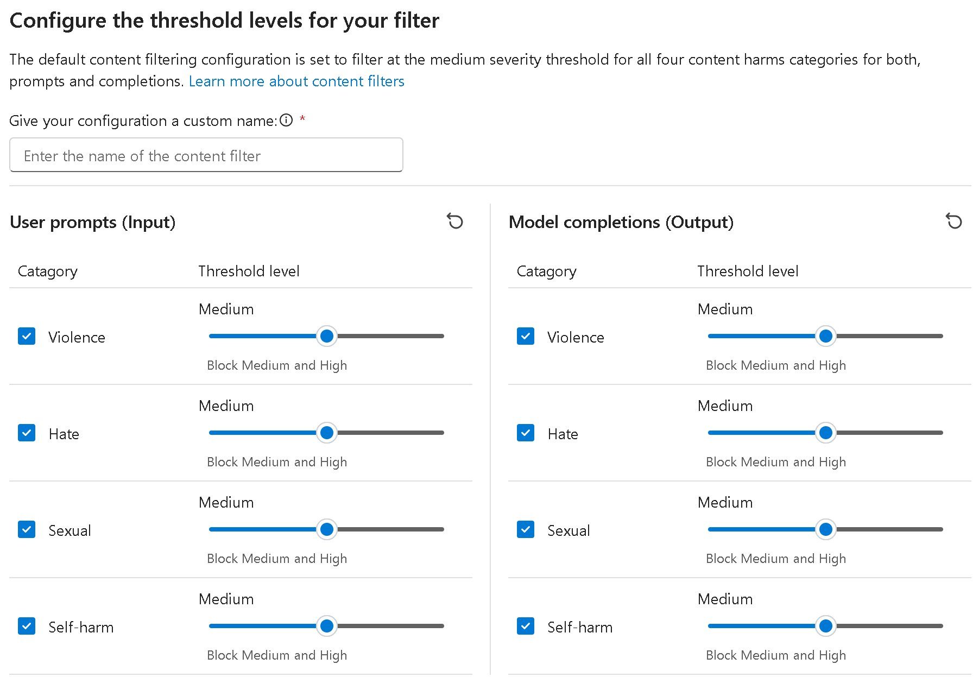
Pioneering new engineering tools and practices
Evaluation and RAI dashboard
Content safety
To learn more, join us for BRK204H: "Evaluating and Designing Responsible AI Systems for the Real World"

Slide 16
Thank you

